Slide 1
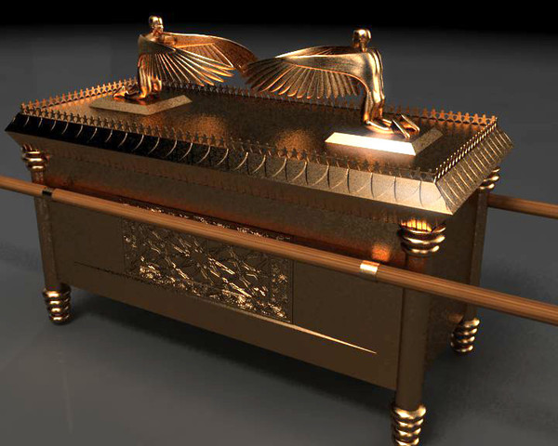
The Ark of the Covenant
A History, with Applications
Notes:
Original lesson prepared by Stan Cox
Preached at West Side church of Christ on June 20, 2013 AM
Print Slides: 1,3-8,19,10,14,16,22 (Six slides per page, front and back. 12 slides total)

Slide 2
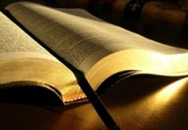
Romans 15:4
For whatever things were written before were written for our learning, that we through the patience and comfort of the Scriptures might have hope.

Slide 3
The Ark of the Covenant
God’s command to Moses to build the Ark of the Covenant (Exodus 25: 10-22) note especially vs. 22
Shittim wood – Probably from a tree that is today known as a Red Acacia, or another species of acacia tree. “The trees yield a valuable, hard, close-grained timber, not readily attacked by insects.” (ISBE)
Cubit – Probably about 20.5 inches. Approximates to about 5’ x 2.5’ x 2.5’
All overlaid with gold, including mercy seat, crown, cherubim, and staves used to carry the Ark.

Slide 4
The Ark of the Covenant
The contents of the Ark
“And you shall put into the ark the Testimony which I will give you” (Exodus 25:16). This “testimony” refers to the 10 commandments, written on stone, received on Mount Sinai (cf. Deuteronomy 10:5).
Consider the following statements in 1 Kings 8, when the Ark first took up its place in the Temple. “There was nothing in the ark save the two tables of stone, which Moses put there at Horeb” (9). Solomon: “And I have set there [in the temple] a place for the ark, wherein is the covenant of the LORD, which he made with our fathers, when he brought them out of the land of Egypt.

Slide 5
The Ark of the Covenant
The contents of the Ark (cont.) What about Hebrews 9:4?
“which had the golden censer and the ark of the covenant overlaid on all sides with gold, in which were the golden pot that had the manna, Aaron’s rod that budded, and the tablets of the covenant.”
Greek word “in which” (hou) can be defined – “at which place.” It is not clear whether the Hebrew writer was indicating the pot of manna and rod were IN the ark, or next to it.
Regardless of whether Moses had put the pot and rod in the ark w/ the tablets, when Solomon placed the ark in the temple, only the tablets remained.

Slide 6
The Ark of the Covenant
Location
Within the holiest of holies, first in the tabernacle (Exodus 26:34); then the temple (1 Kings 8:6)
History
Traveled with the children of Israel throughout the wanderings in the wilderness, and in their possession of the land of Canaan.
During the rule of Eli as judge over Israel, the ark was taken by the Philistines. “The glory is departed from Israel: for the ark of God is taken” (Phinehas’ wife, 1 Samuel 4:22).

Slide 7
The Ark of the Covenant
History (cont.)
God plagued the Philistines for the 7 months the ark was in their possession (1 Samuel 5).
The Philistines sent the ark to Bethshemesh (1 Samuel 6), probably an area in Judah, near the border between Judah and the Philistines. The men of Bethshemesh sinned by looking into the ark, and God smote them (1 Samuel 6:19).
The men of Bethshemesh called on the men of Kirjathjearim (located on the border of Judah and Benjamin) to come get the ark (1 Samuel 6:21).

Slide 8
The Ark of the Covenant
History (cont.)
The ark remained at Kirjathjearim for 20 years (1 Samuel 7:2).
David brought the ark to Jerusalem (2 Samuel 6)
Solomon put the ark of the covenant in the Temple (2 Kings 8), where it in all probability remained until the temple was destroyed at Judah’s defeat at the hands of the Babylonians.
There is no direct mention of its end contained anywhere in scripture.

Slide 9
Lessons to be learned
God’s instructions are to be followed (Exodus 25:10-21) (the materials and building of the ark)

Slide 10
What if God’s instructions are NOT followed?
Achan (Took the profane things from Jericho)
“Then it shall be that he who is taken with the accursed thing shall be burned with fire, he and all that he has, because he has transgressed the covenant of the Lord, and because he has done a disgraceful thing in Israel” (Joshua 7:15).
Nadab & Abihu (Took fire that God “had not commanded them”, Leviticus 10:1)
“So fire went out from the Lord and devoured them, and they died before the Lord” (Leviticus 10:2).

Slide 11
Leviticus 10:3
And Moses said to Aaron, “This is what the Lord spoke, saying: ‘By those who come near Me I must be regarded as holy; And before all the people I must be glorified.’” So Aaron held his peace.
The Lord’s explanation as to why Nadab and Abihu were punished for not heeding God’s instruction regarding worship.

Slide 12
Matthew 7:21-23
“Not everyone who says to Me, ‘Lord, Lord,’ shall enter the kingdom of heaven, but he who does the will of My Father in heaven. ²² Many will say to Me in that day, ‘Lord, Lord, have we not prophesied in Your name, cast out demons in Your name, and done many wonders in Your name?’ ²³ And then I will declare to them, ‘I never knew you; depart from Me, you who practice lawlessness!’”

Slide 13
Lessons to be learned
God’s instructions are to be followed (Exodus 25:10-21) (the materials and building of the ark)
When the glory of God departs (1 Samuel 4:22) (the taking of the ark by the Philistines)

Slide 14
What if the Glory of God Departs?
Israel (Jericho/Ai)
“So about three thousand men went up there from the people, but they fled before the men of Ai. ⁵ And the men of Ai struck down about thirty-six men, … therefore the hearts of the people melted and became like water” (Joshua 7:4-5).
In contrast, success is assured with God’s help!
“I know how to be abased, and I know how to abound. Everywhere and in all things I have learned both to be full and to be hungry, both to abound and to suffer need. ¹³ I can do all things through Christ who strengthens me.” (Philippians 4:12-13).

Slide 15
Lessons to be learned
God’s instructions are to be followed (Exodus 25:10-21) (the materials and building of the ark)
When the glory of God departs (1 Samuel 4:22) (the taking of the ark by the Philistines)
The concept of Sanctification (Exodus 25:22) (God must be revered by His people)

Slide 16
The Ark of the Covenant was a Holy Object!
Placed in the Holiest place, and from there God’s voice instructed Moses.
The inner sanctum of the tabernacle (and Temple) were not accessible to Israel.
The High Priest entered once a year for the sacrifice of atonement (Leviticus 16)
“And the Lord said to Moses: ‘Tell Aaron your brother not to come at just any time into the Holy Place inside the veil, before the mercy seat which is on the ark, lest he die; for I will appear in the cloud above the mercy seat’” (Leviticus 16:2)

Slide 17
Leviticus 11:45
For I am the Lord who brings you up out of the land of Egypt, to be your God. You shall therefore be holy, for I am holy.
God demands reverence, respect and righteousness of His children. This is so because of who He is.

Slide 18
Romans 12:1-2
I beseech you therefore, brethren, by the mercies of God, that you present your bodies a living sacrifice, holy, acceptable to God, which is your reasonable service. ² And do not be conformed to this world, but be transformed by the renewing of your mind, that you may prove what is that good and acceptable and perfect will of God.

Slide 19
Lessons to be learned
God’s instructions are to be followed (Exodus 25:10-21) (the materials and building of the ark)
When the glory of God departs (1 Samuel 4:22) (the taking of the ark by the Philistines)
The concept of Sanctification (Exodus 25:22) (God must be revered by His people)
The consequences of disobedience (2 Samuel 6:6-7) (The case of Uzzah)

Slide 20
Romans 1:28-32
And even as they did not like to retain God in their knowledge, God gave them over to a debased mind, to do those things which are not fitting; ²⁹ being filled with all unrighteousness, sexual immorality, wickedness, covetousness, maliciousness; full of envy, murder, strife, deceit, evil-mindedness; they are whisperers, ³⁰ backbiters, haters of God, violent, proud, boasters, inventors of evil things, disobedient to parents, ³¹ undiscerning, untrustworthy, unloving, unforgiving, unmerciful; ³² who, knowing the righteous judgment of God, that those who practice such things are deserving of death, not only do the same but also approve of those who practice them.

Slide 21
Revelation 20:13-15
The sea gave up the dead who were in it, and Death and Hades delivered up the dead who were in them. And they were judged, each one according to his works. ¹⁴ Then Death and Hades were cast into the lake of fire. This is the second death. ¹⁵ And anyone not found written in the Book of Life was cast into the lake of fire.

Slide 22
Conclusion
The Ark of the Covenant held a special significance to the people of Israel. God instructed them from between the cherubim on the mercy seat.
As Christians we too should be reverent and obedient to God as we consider the gravity of being in His presence. “Let us therefore come boldly to the throne of grace, that we may obtain mercy and find grace to help in time of need” (Hebrews 4:16).

